Slide 1


Ims Personal project
QA Consulting
Alexander Walker

Slide 2

Ims Starter
Introduction and familiarisation with the specification
Consultant journey
Continuous integration
Testing
Demonstration
Spring review
Spring retrospective
Conclusion
Q&A

Slide 3
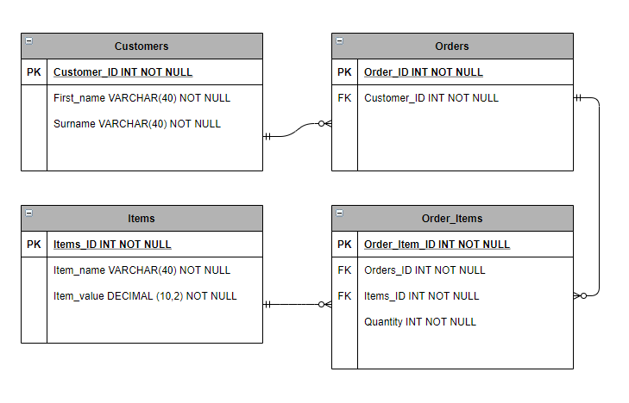
Introduction and Specification
Inventory Management System
User wants an application that may have access to three sections:
Customers, items, and orders
CRUD
Create, read, update, and delete
Cost of a single order
Add and delete items from orders

Slide 4
Consultant Journey
Professional skills, employability and communication
GitHub – Source Code Management
MySQL – Database managemnt system
GCP - Cloud fundamentals
Markdown – Text editing
JAVA Beginner and Intermediate – Backend programming
Maven – Build Tool
JUnit Testing – Unit Testing
SonarQube – Refactoring
Agile fundamentals including Scrum
JIRA – Project management / Kanban Board
Git – Version contol

Slide 5
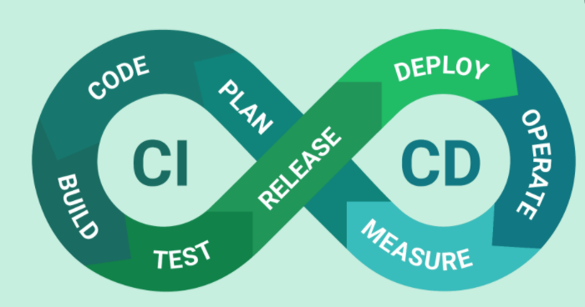
Continuous integration
Kanban board – JIRA
Git – Version control
GitHub – Source code management
JAVA – back-end programming
Maven – build tool
JUnit – Testing

Slide 6

JIRA
The use of Epics, user stories and tasks
Story points were implemented throughout all user stories.
MoSCoW prioritization was used through JIRA prioritization.
Setting up smart commits with GitHub in preparation for coding.

Slide 7
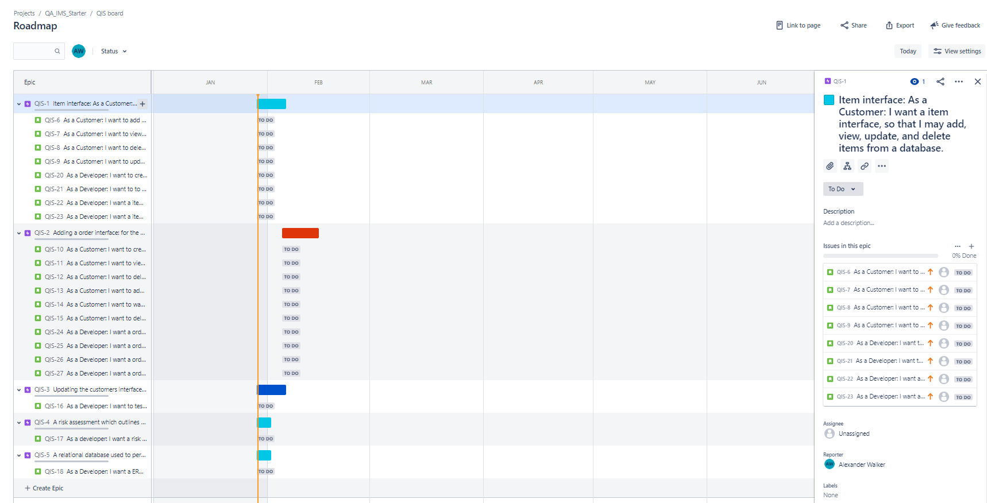
JIRA

Slide 8
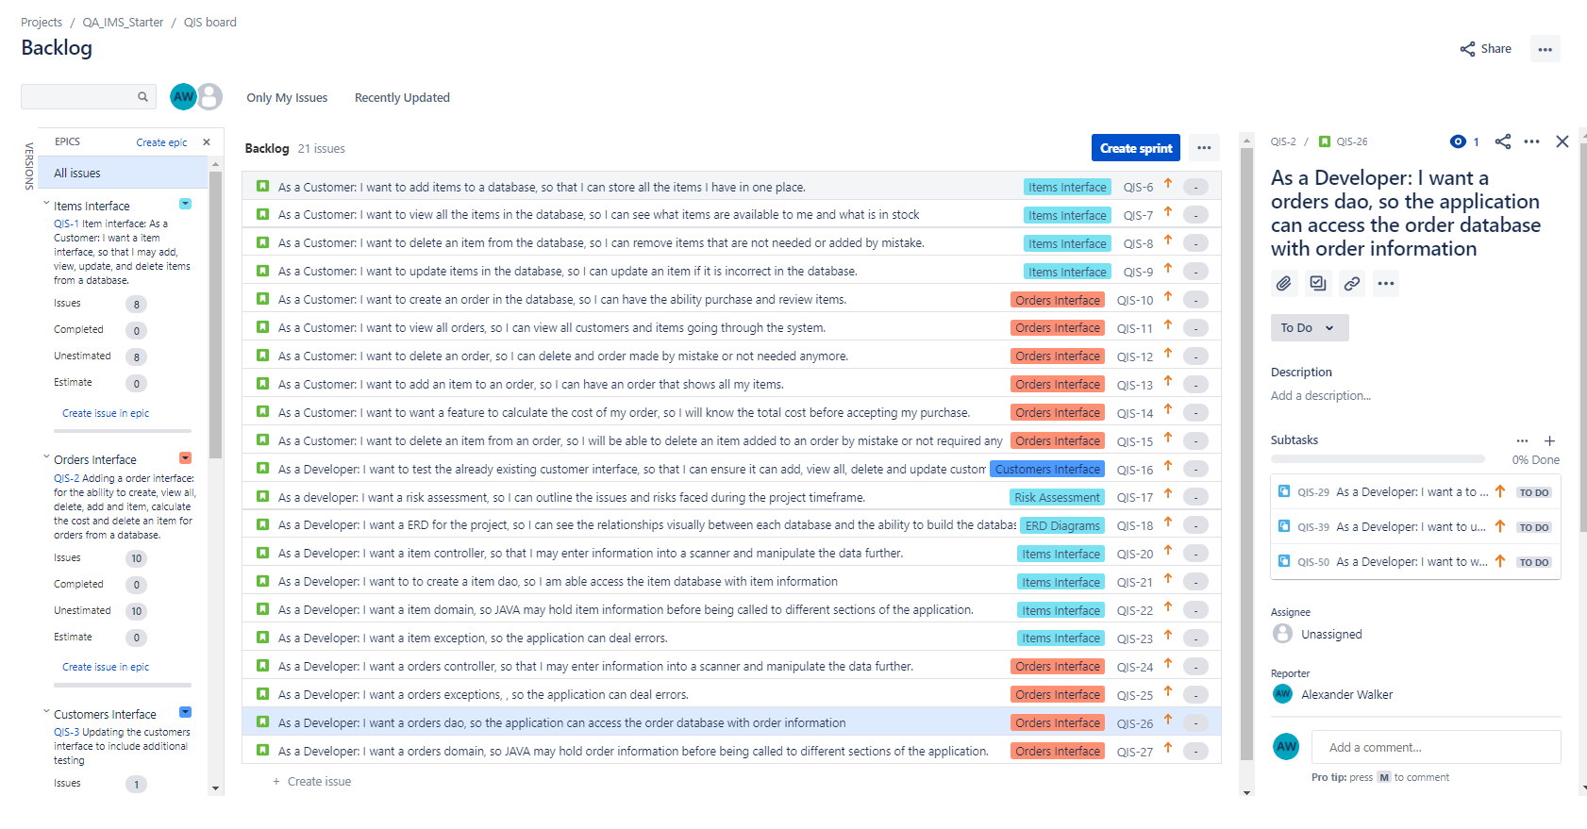

Slide 9
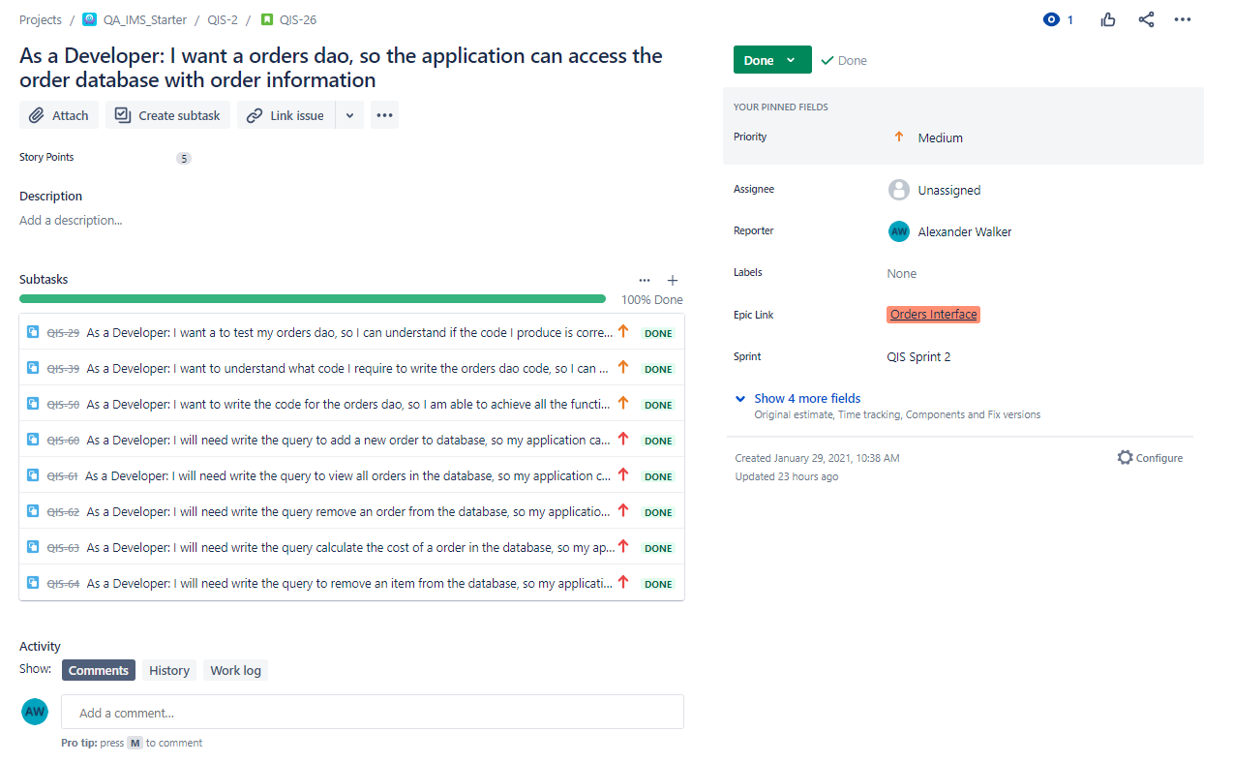

Slide 10
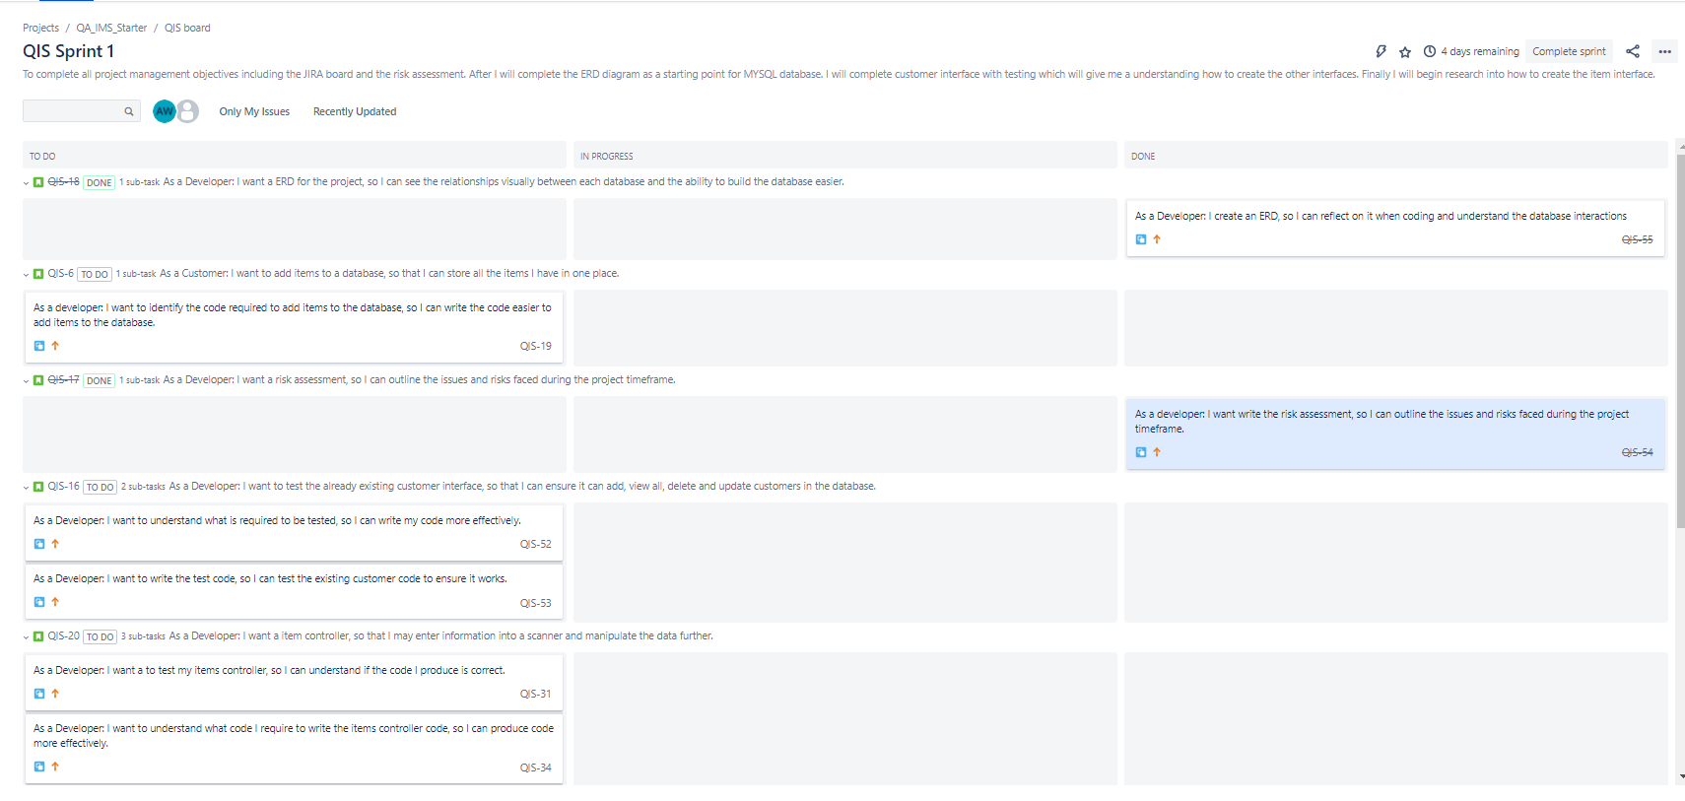

Slide 11
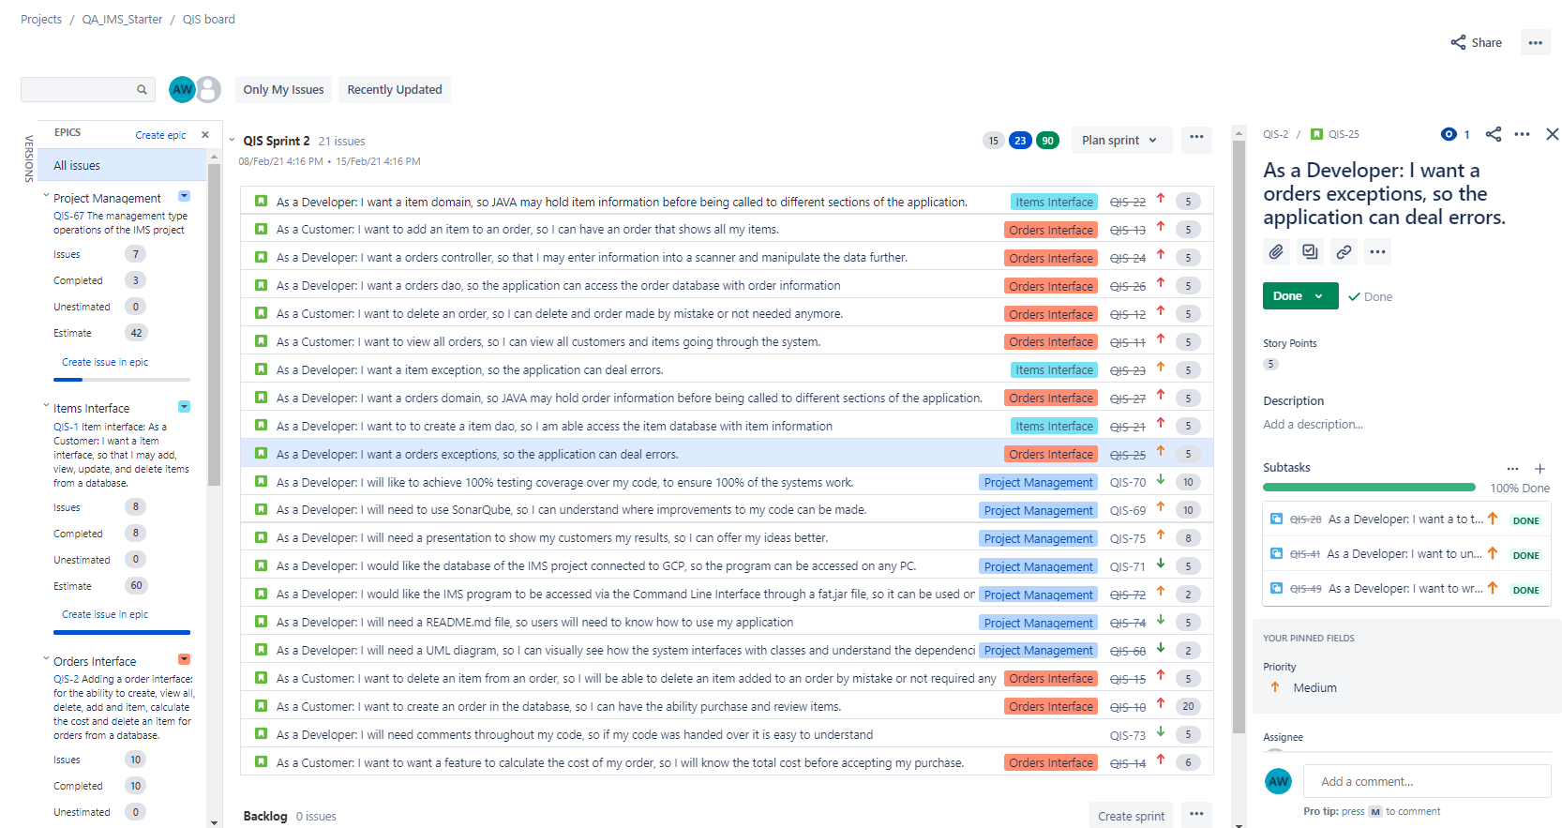

Slide 12
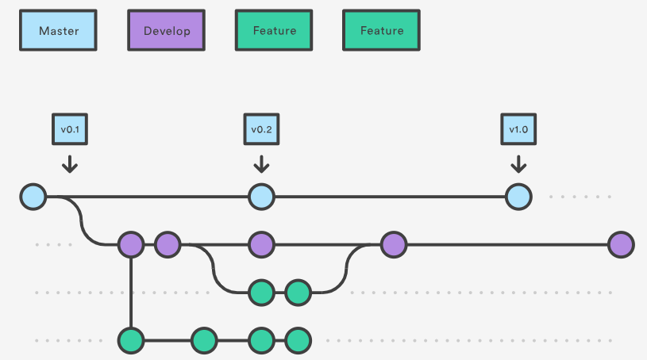
Git & GitHub
Forked IMS
The Clone to local machine
Implementing the feature branch model
Branches include:
Master
Development
Feature - Items
Feature - Orders
Feature - Testing
Feature - Refactoring
Feature - Project Management

Slide 13
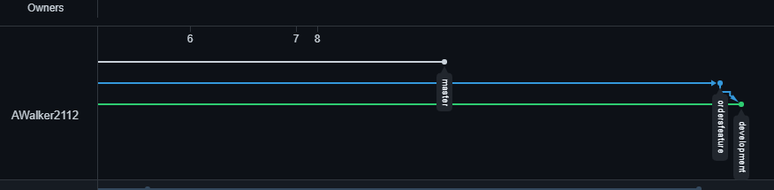
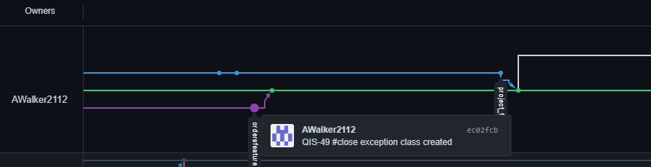
Git & GitHub

Slide 14
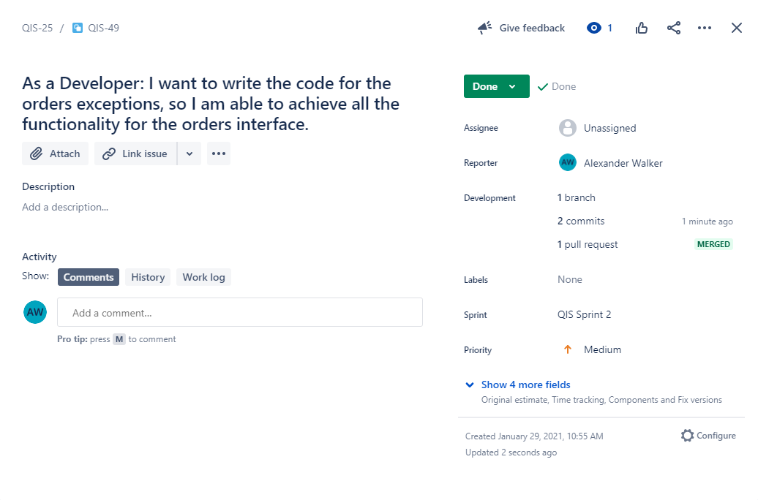

Slide 15
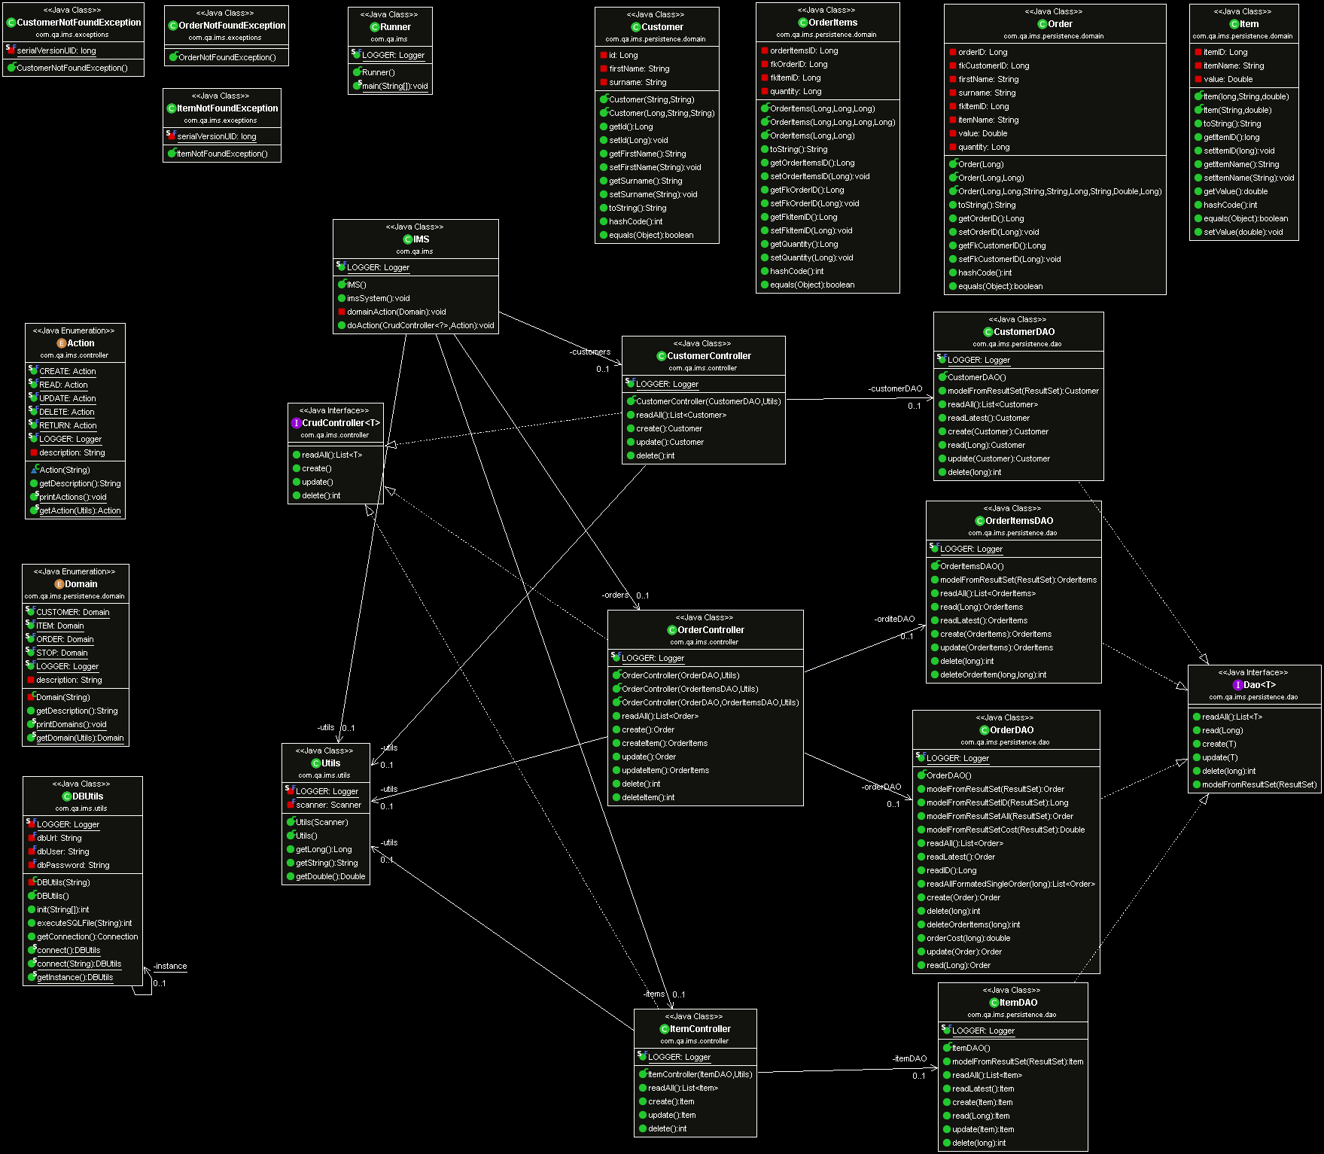

Slide 16
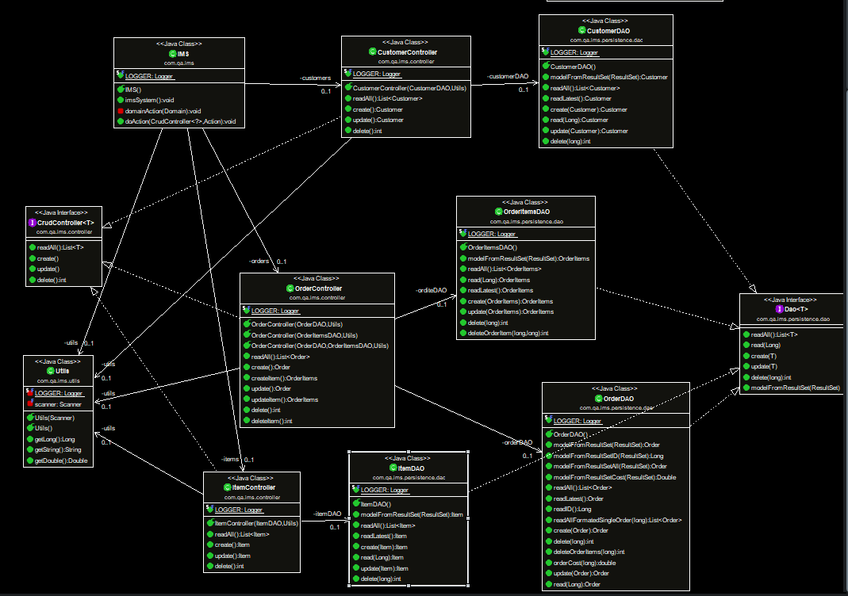

Slide 17
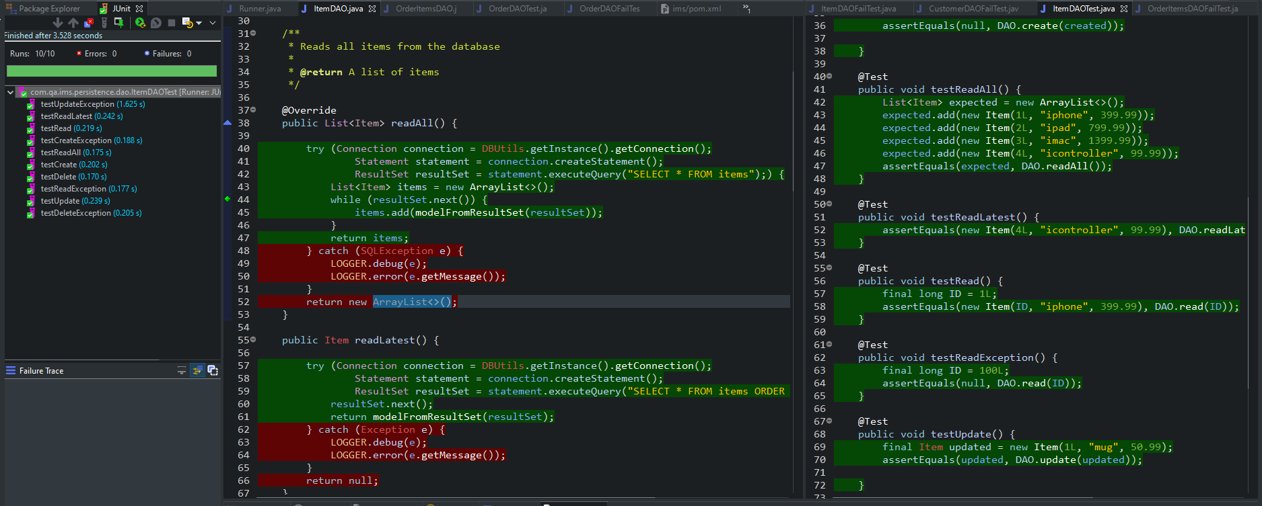
Testing

Slide 18
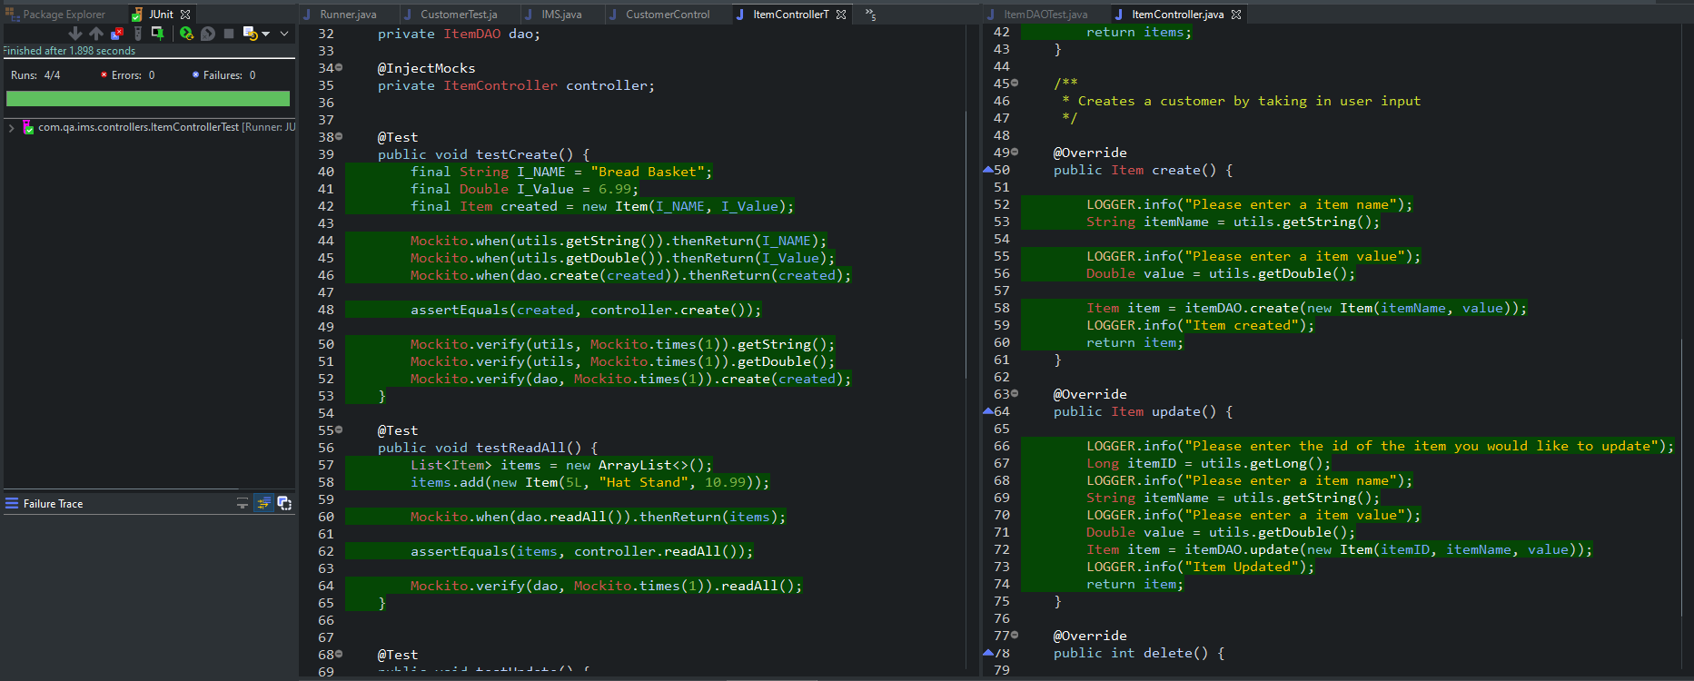
Testing

Slide 19
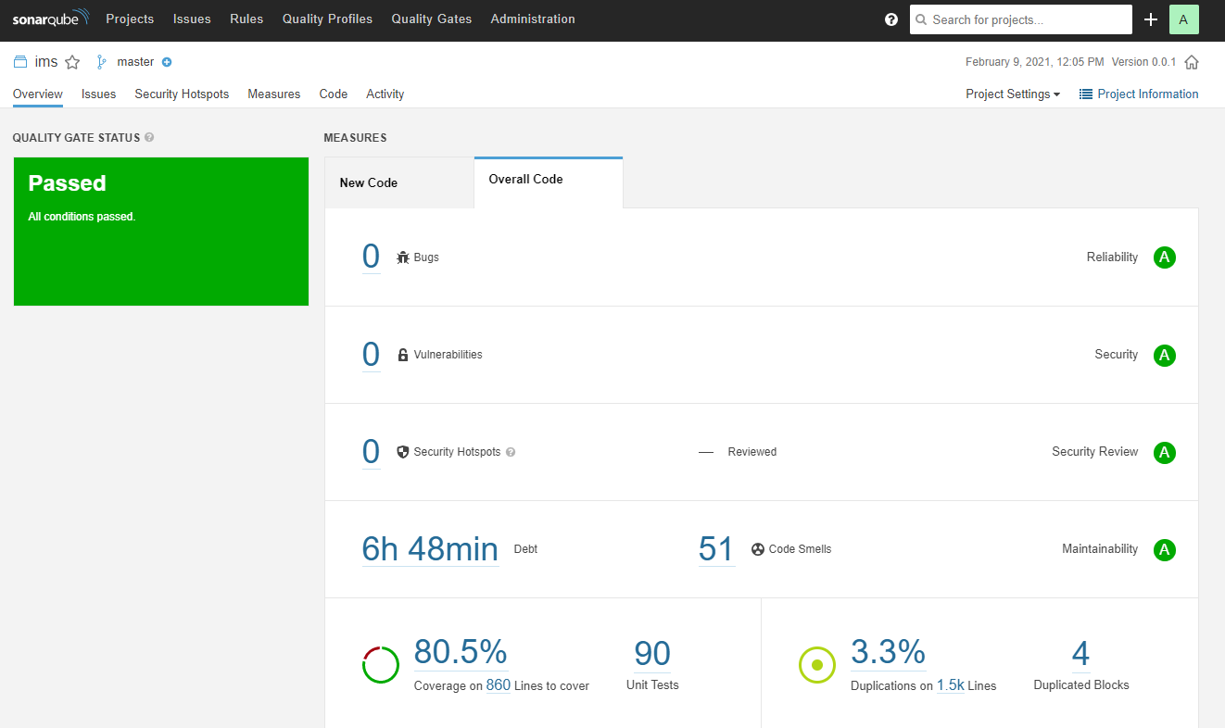
Testing

Slide 20
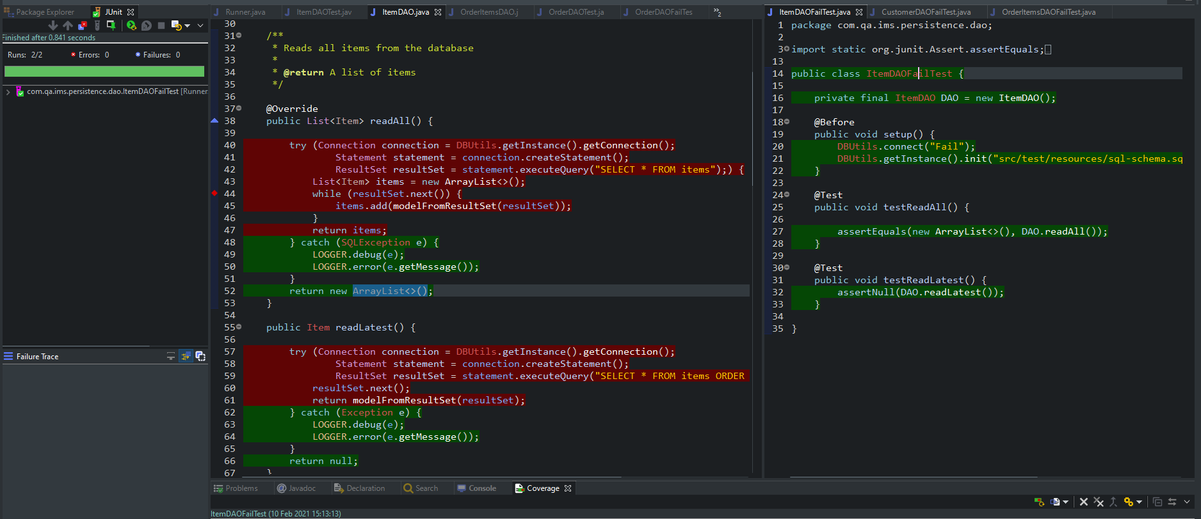
Testing

Slide 21
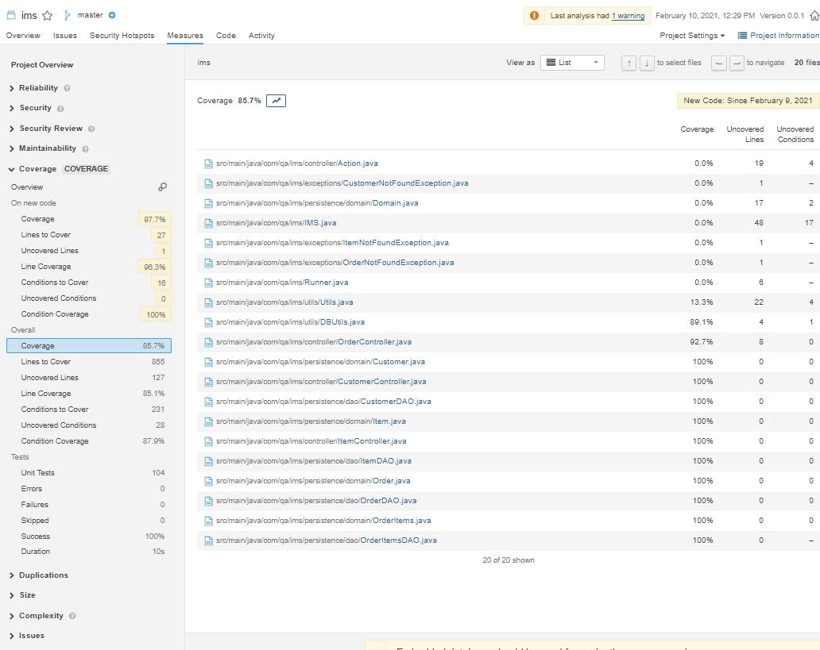
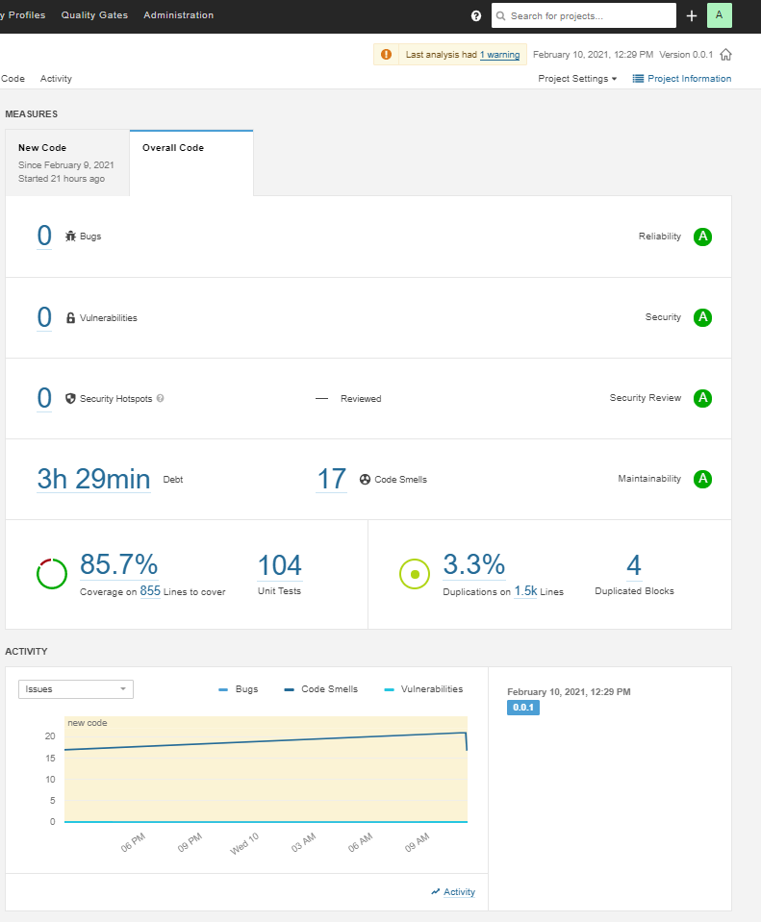
Testing

Slide 22

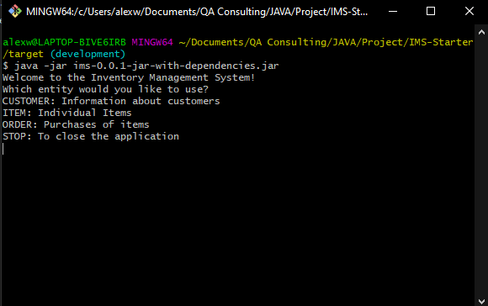
Demonstration

Slide 23
Sprint review – what was completed
Codebase:
Add a customer to the system
View all customers in the system
Update a customer in the system
Delete a customer in the system
Add an item to the system
View all items in the system
Update an item in the system
CRUD functionality connections to a MySQL database via JDBC.
Delete an item in the system
Create an order in the system
View all orders in the system
Delete an order in the system
Add an item to an order
Calculate a cost for an order
Delete an item in an order
Sensible package structure

Slide 24
Sprint review – what was completed
Testing:
Testing up to 85.7% coverage
SonarQube and refactoring
Continuous Integration:
Git repository using the feature branch model
Fat jar application
Repository and Documentation:
Successful JIRA board implementing smart commits
Working .gititgore
An updated README.md
Risk assessment
x2 ERD diagram and x1 UML diagram

Slide 25
Sprint Review – left behind
Missing
feature-<concept> naming convention
GCP connection.
100% test coverage.
SQL error replaced with a user friendly error.
Email and phones to the customer.
Descriptions for the items.

Slide 26
Sprint retrospective – what went well
JIRA board
UML, ERD diagram and Risk Assessment
Git was successful
The IMS application was successful
Time management

Slide 27
Sprint retrospective – what could be improved
Improvements
Understanding Git further Indepth
Understanding JAVA further Indepth through OOP and SOLID principals.
Increased continuous integration through smaller TDD
The IMS application could be neater
The IMS application could include error statements
Removing the Order-Items classes completely

Slide 28
Conclusion
IMS specification
Consultant Journey - Great start to digital consultancy and building my first application
CI - Skills in various technologies have vastly increased over the project
Testing
Demonstration
Spring Review and Retrospective
Ive really enjoyed it, being independent and working through the requirements
Looking forward to starting salesforce next week

Slide 29
Thank you for Listening

